Slide 1

Operational Technology Security Patch Management System
Isaac Tan
February 2024

Slide 2
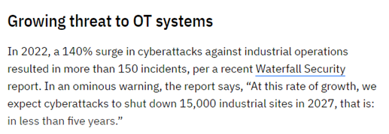
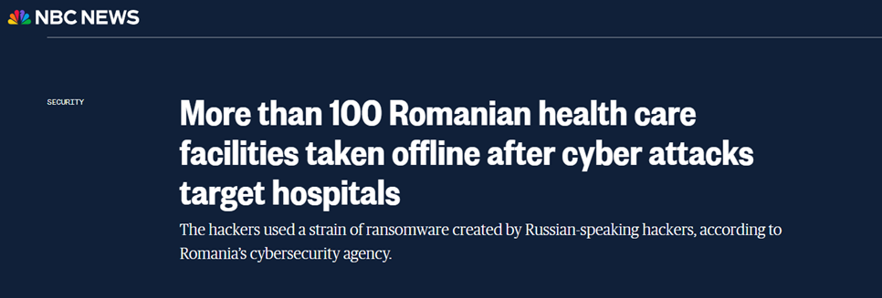
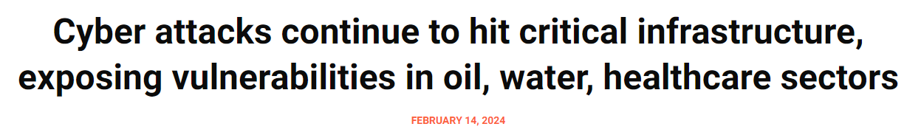
Business Problems/Challenges

Slide 3
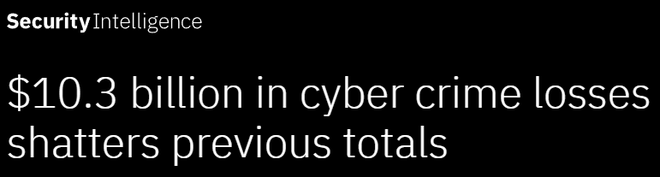
Business Problems/Challenges

Slide 4


The Solution
Strengthen IoT Security
Consultancy Services

Slide 5
Business Impacts
Feature-Rich
Ensures Cybersecurity
International Recognition and Credibility
First in Southeast Asia

